Slide 1
DIGITAL LOGIC DESIGN
EE(109)

Slide 2
Chapter No:6
Function of combinational logic

Slide 3
TOPICS
Half and Full Adders
Parallel Binary Adders
Comparators
Decoders
Encoders
Code Converters
Multiplexers (Data Selectors)
Demultiplexers

Slide 4
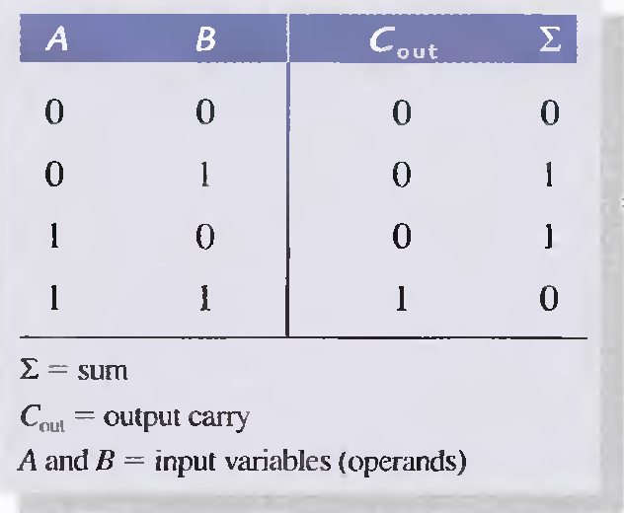
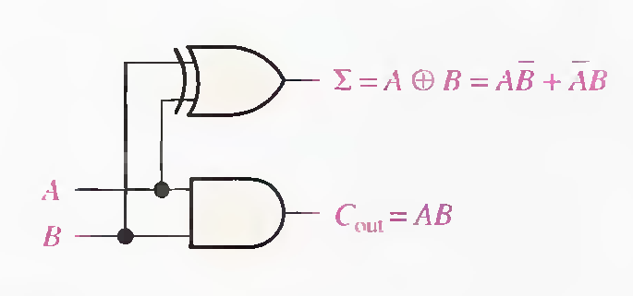
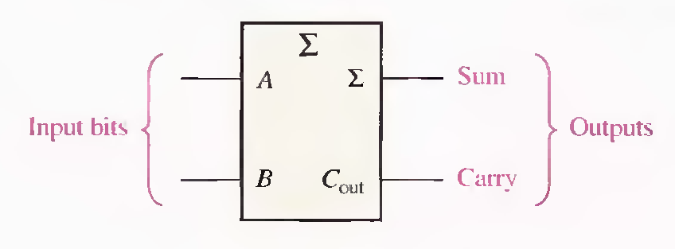

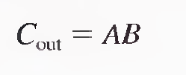
BASIC ADDERS
The Half-Adder

Slide 5

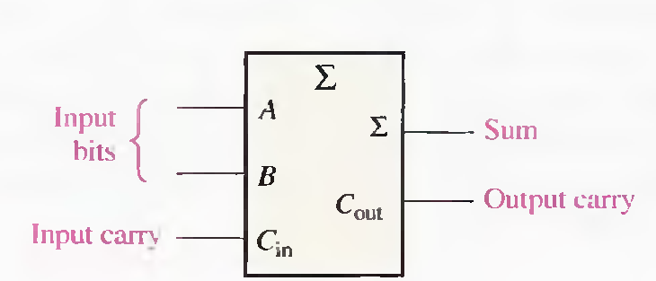

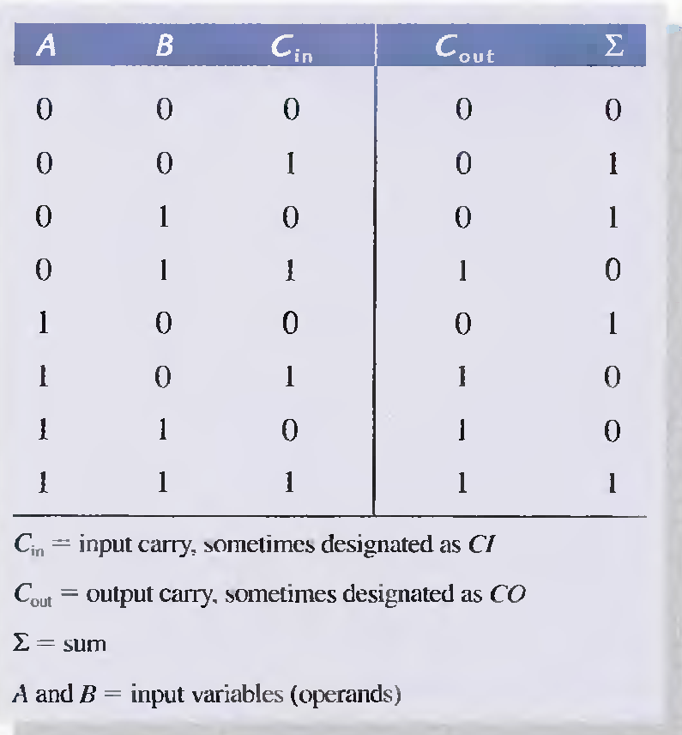

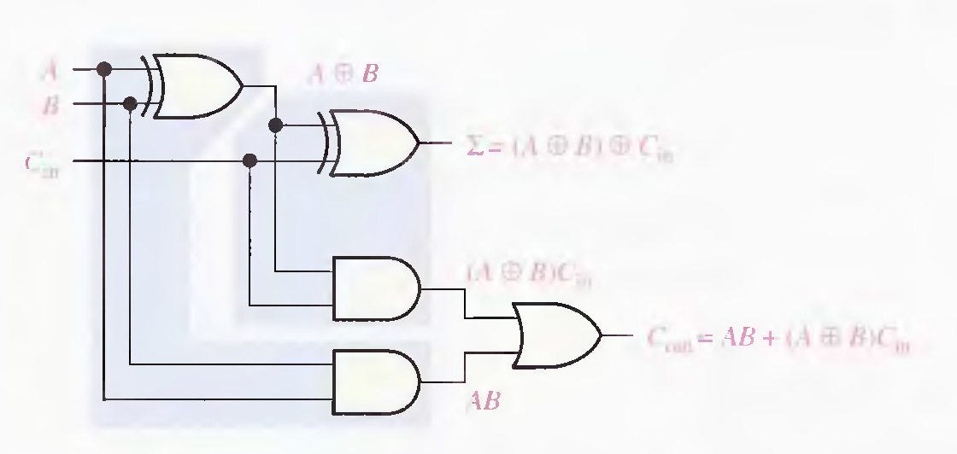

Slide 6
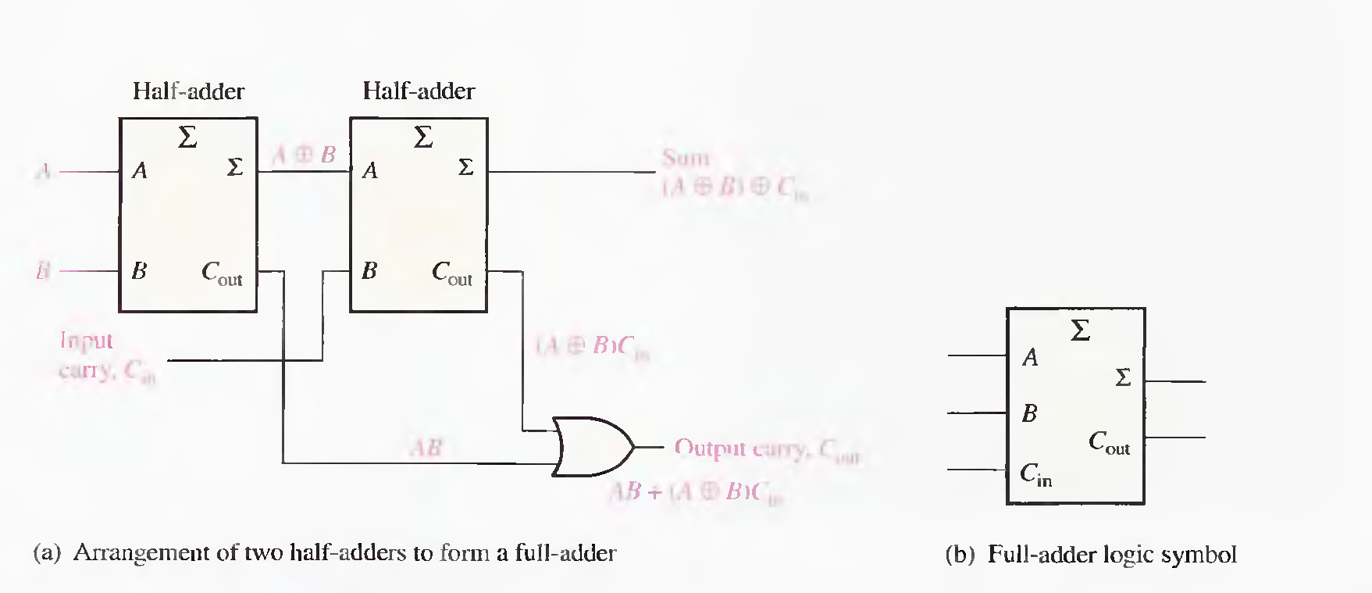


Slide 7
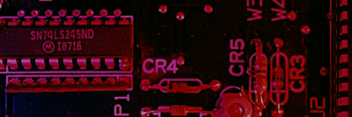
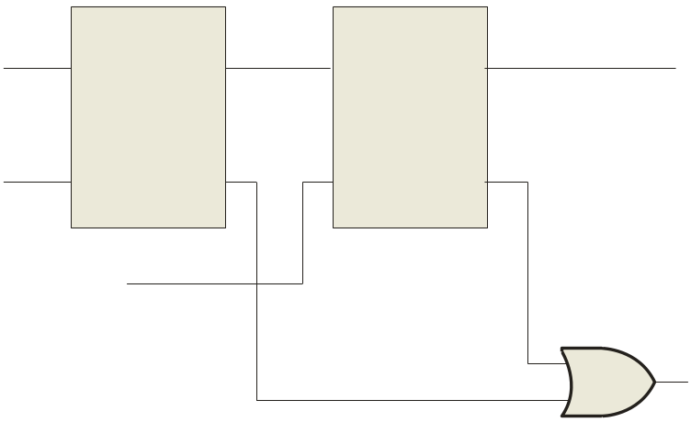

Summary
Full-Adder
Σ
Σ
1
Σ
Σ
0
Sum
1
A
A
Example
B
0
1
0
C_{out}
B
C_{out}
For the given inputs, determine the intermediate and final outputs of the full adder.
1
C_{out}
1
Solution
The first half-adder has inputs of 1 and 0; therefore the Sum =1 and the Carry out = 0.
The second half-adder has inputs of 1 and 1; therefore the Sum = 0 and the Carry out = 1.
The OR gate has inputs of 1 and 0, therefore the final carry out = 1.

Slide 8
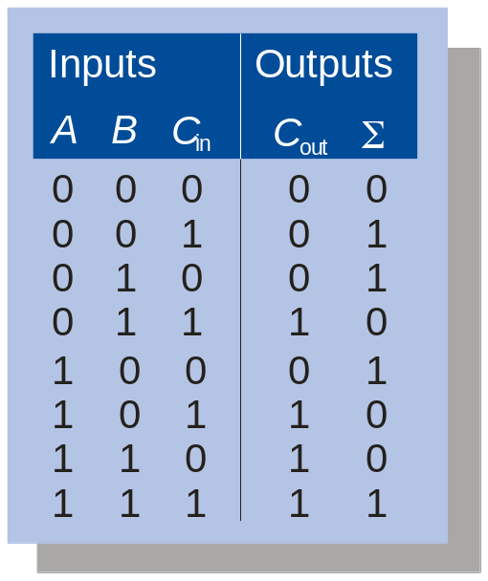
Summary
Full-Adder
Notice that the result from the previous example can be read directly on the truth table for a full adder.
Σ
Σ
1
Σ
Σ
0
Sum
1
A
A
B
0
1
0
C_{out}
B
C_{out}
1
C_{out}
1

Slide 9

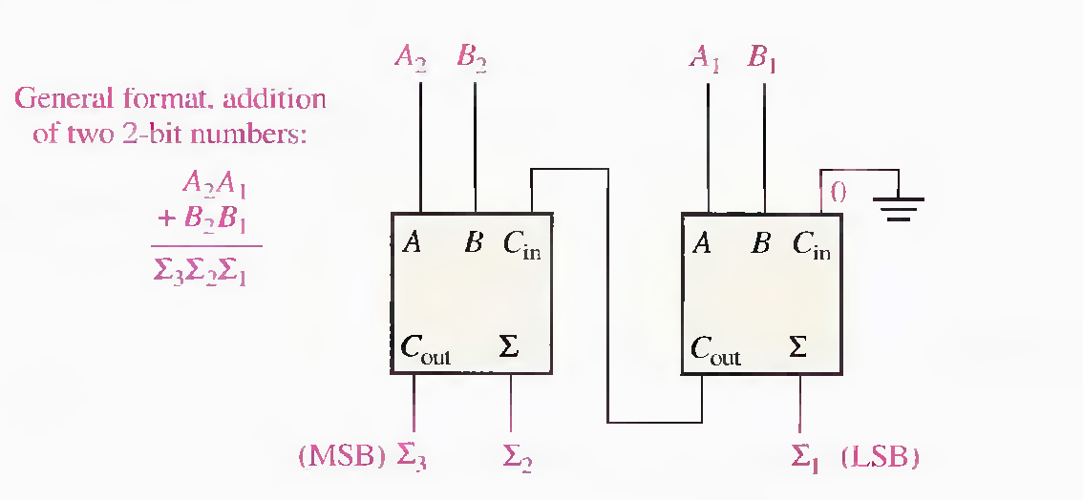
PARALLEL BINARY ADDERS
Two or more full-adders are connected to form parallel binary adders.
A single full-adder is capable of adding two, I-bit numbers
and an input carry. To add binary numbers with more than one bit, you must use additional full-adders.

Slide 10

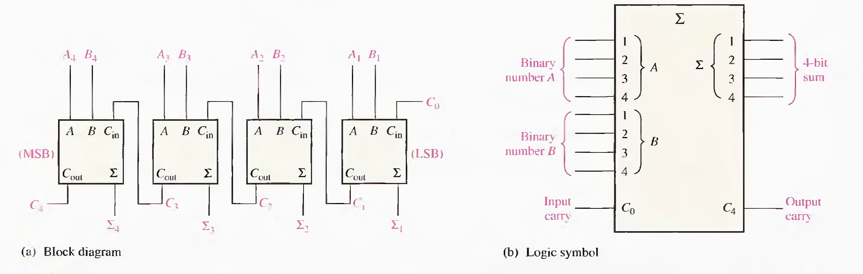
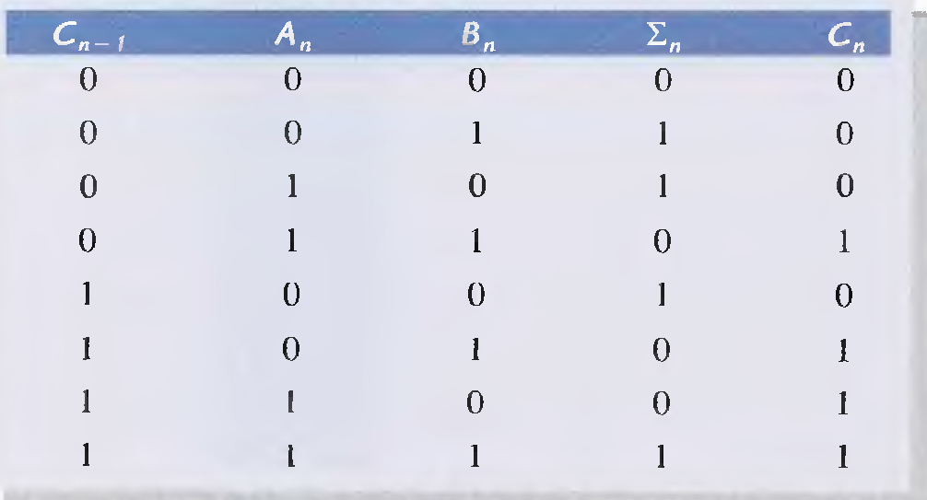
A group of four bits is called a nibble. A basic 4-bit parallel adder is implemented with four full-adder stages .

Slide 11

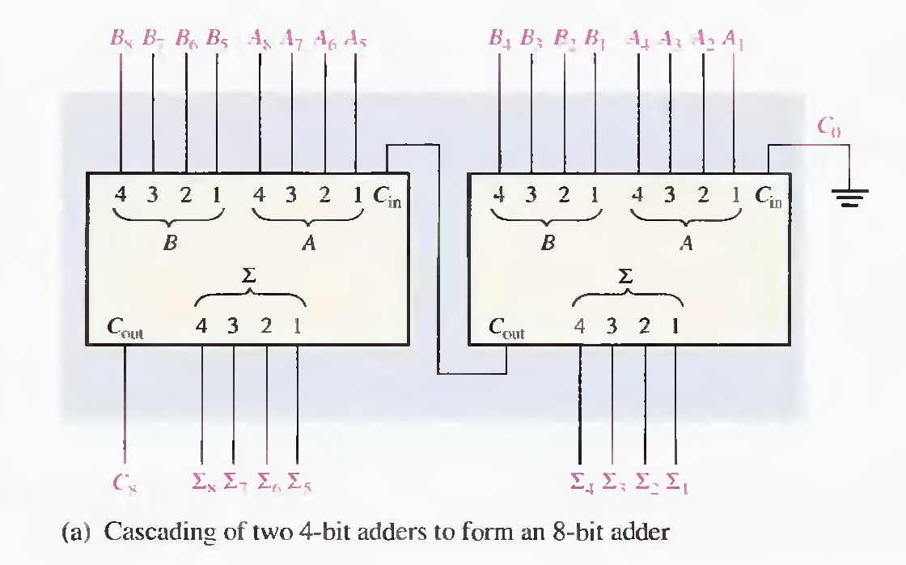
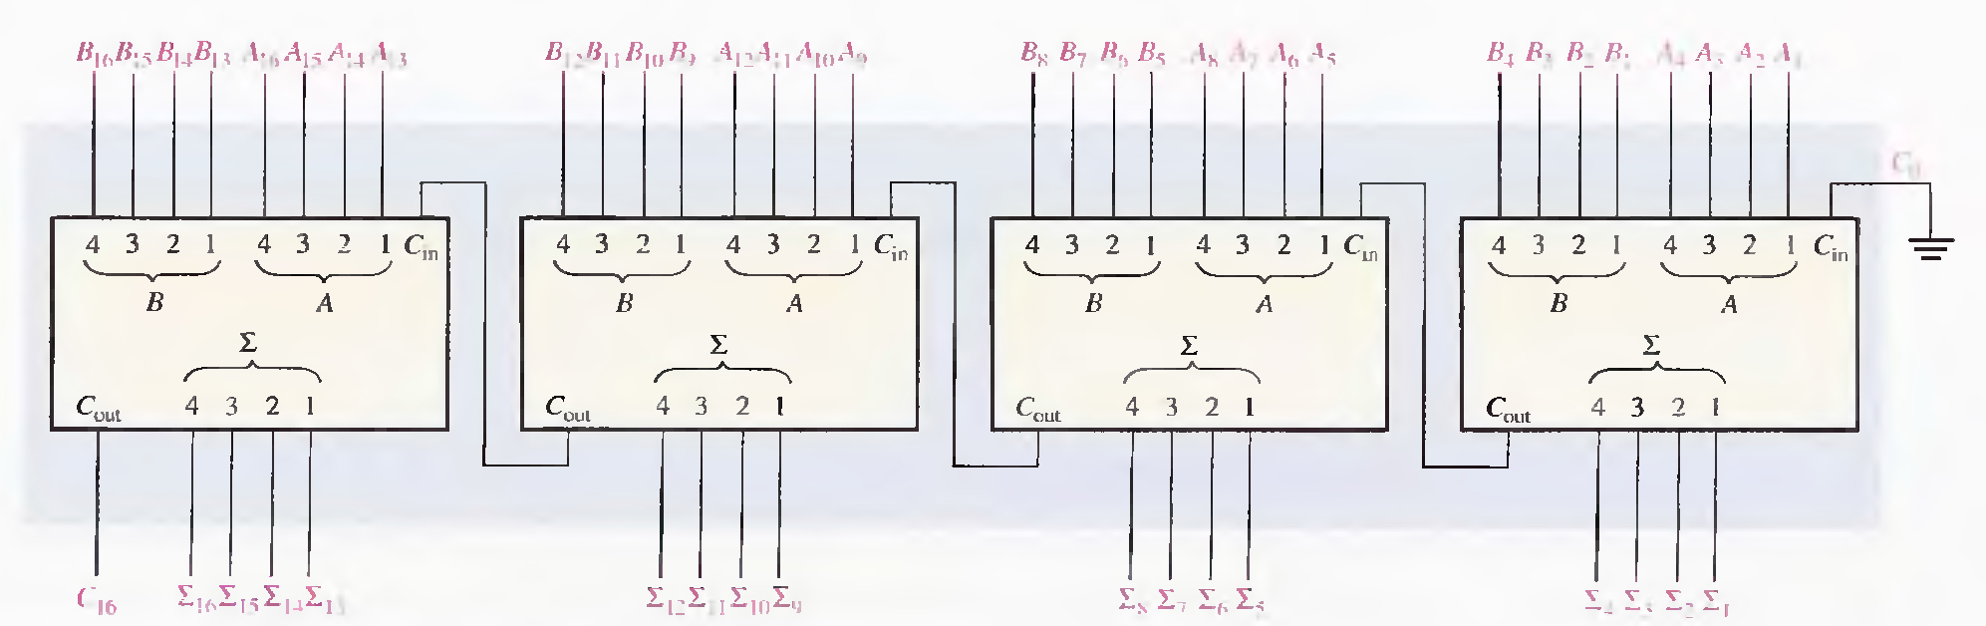
Cascading: The 4-bit parallel adder can be expanded to handle the addition of two 8-bit numbers by using two 4-bit adders. The carry input of the low-order adder (Co) is connected to ground because there is no carry into the least significant bit position, and the carry output of the low-order adder is connected to the carry input of the high-order adder, as shown in Figure . This process is known as cascading.

Slide 12

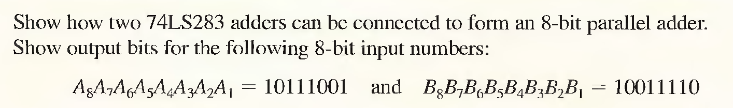
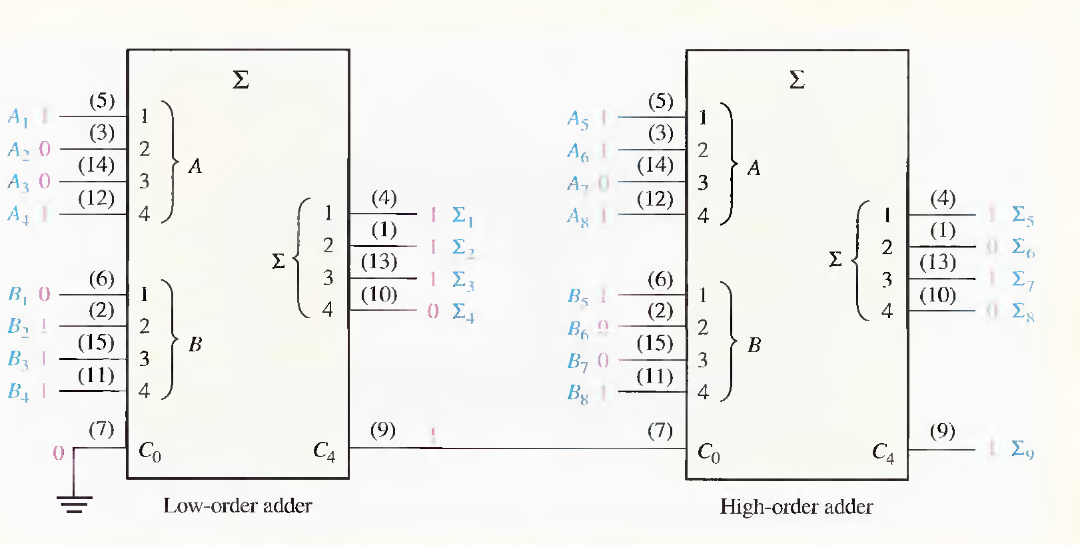


Slide 13
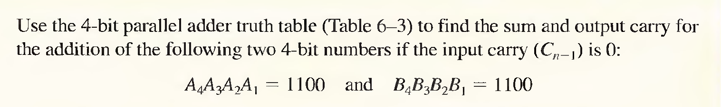
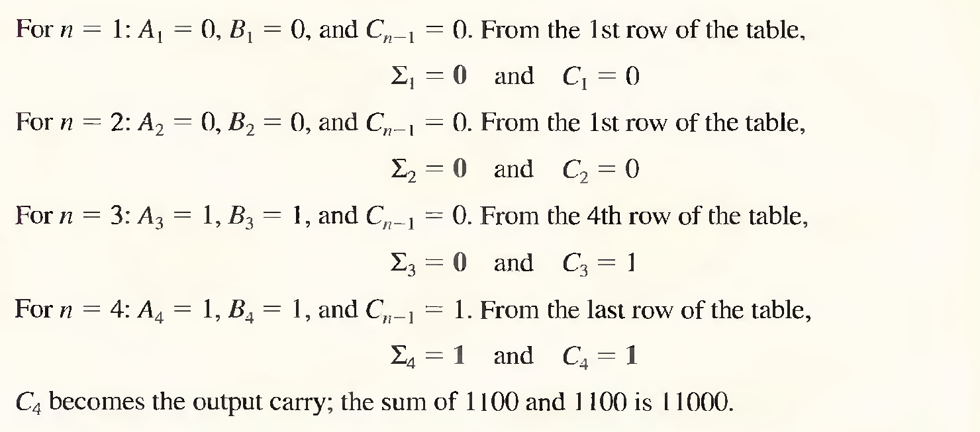

Slide 14


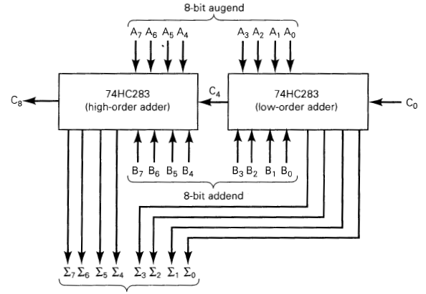

Slide 15


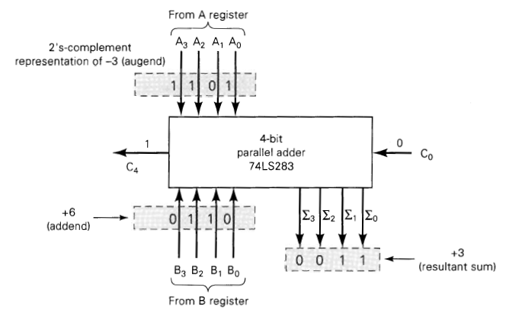

Slide 16
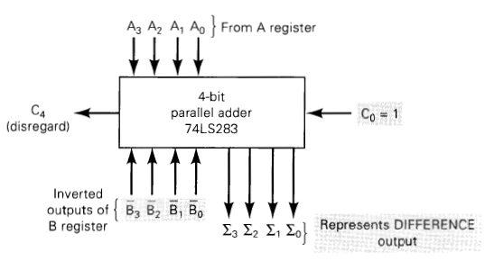
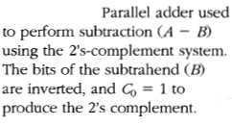
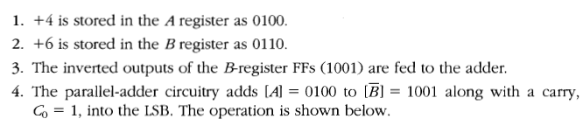
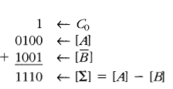

Slide 17
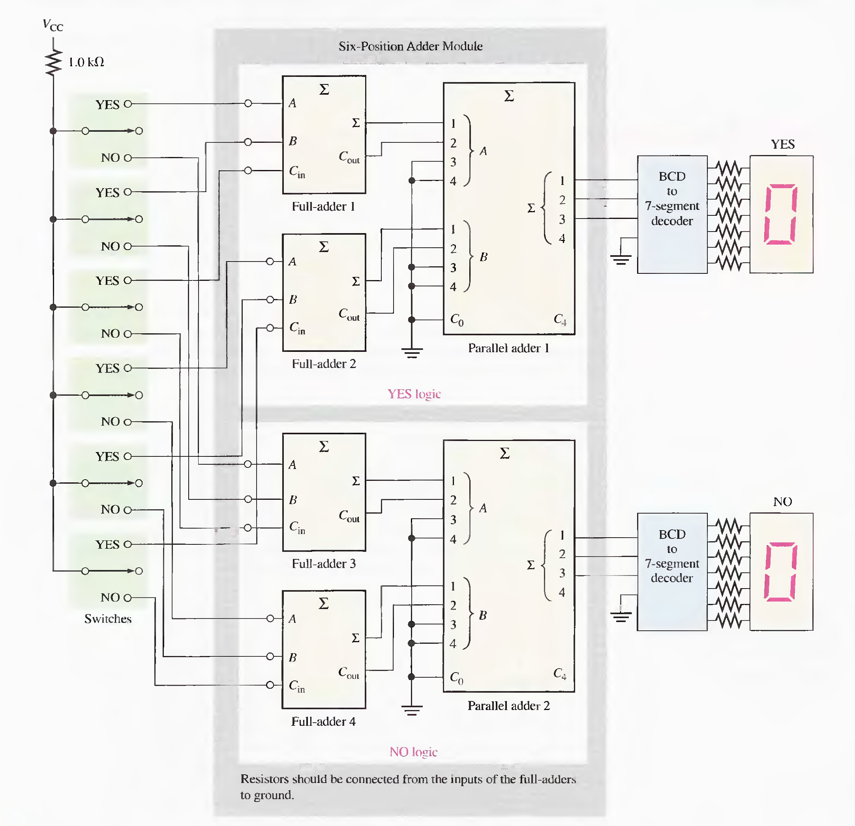
In its simplest form, the system includes a switch for "yes" or "no" selection at each position in the assembly and a digital display for the number of yes votes and one for the number of no votes.

Slide 18

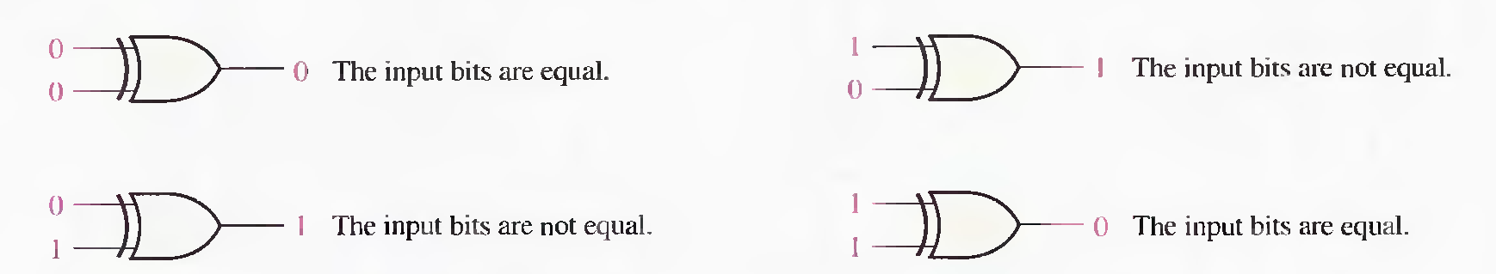
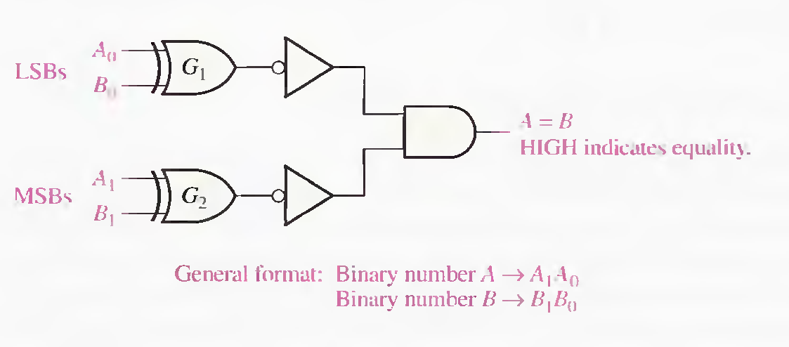

COMPARATOR
The basic function of a comparator is to compare the magnitudes of two binary quantities to determine the relationship of those quantities.

Slide 19

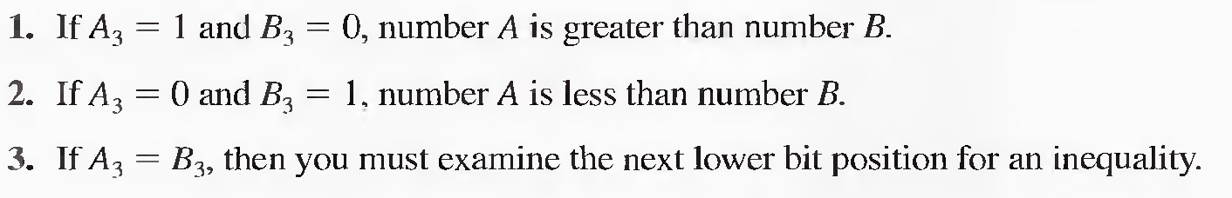
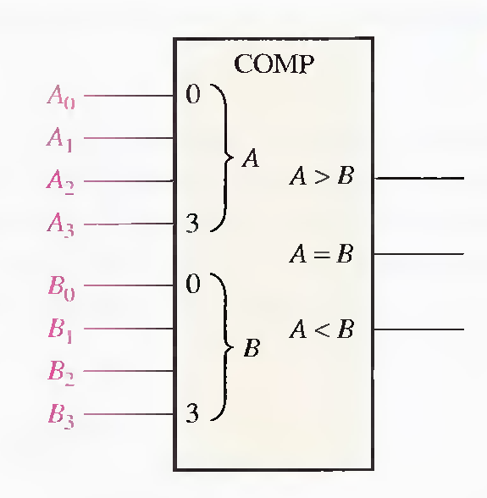
The highest-order indication must take precedence.

Slide 20
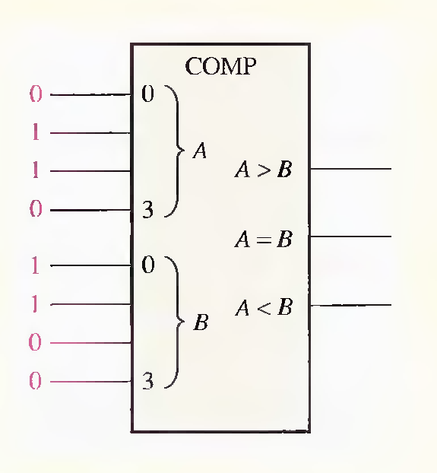
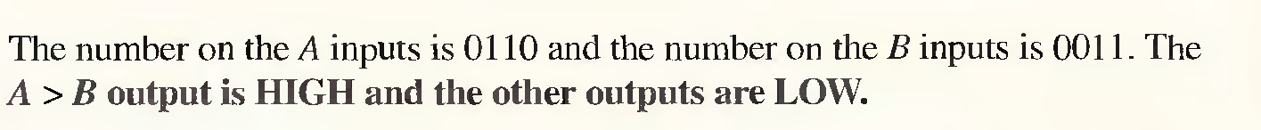
Determine the A = B, A > B, and A < B outputs for the input numbers shown on the comparator in Figure .

Slide 21
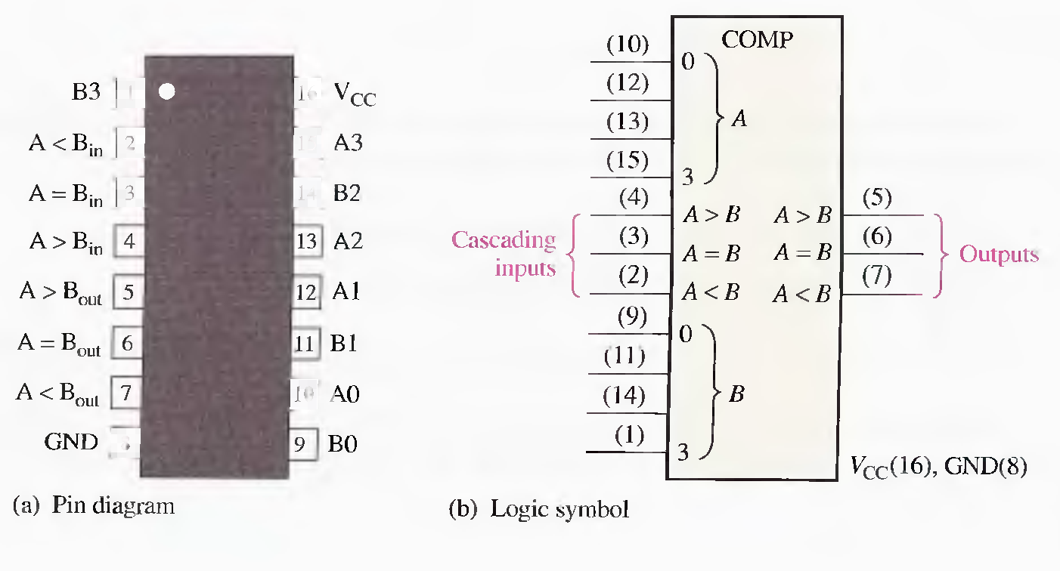
The 74HC85 is a comparator that is also available in other IC families. The pin diagram and logic symbol are shown in Figure 0-24. Notice that this device has all the inputs and outputs of the generalized comparator previously discussed and, in addition, has three cascading inputs: A < B, A = B, A > B. These inputs allow several comparators to be cascaded for comparison of any number of bits greater than four.

Slide 22
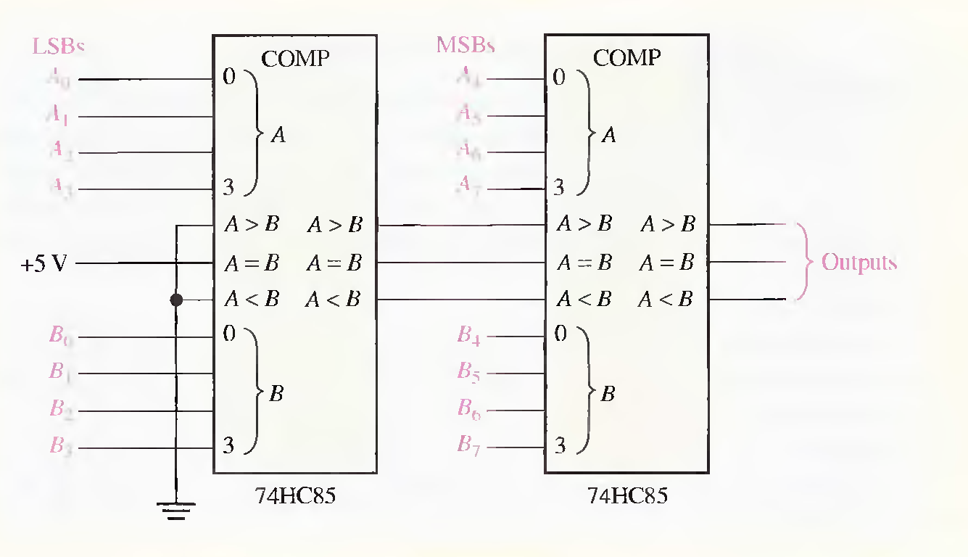
Compare two 8-bit numbers:
Two 74HC85s are required to compare two 8-bit numbers. They are connected as
shown in Figure in a cascaded arrangement.

Slide 23
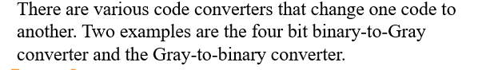


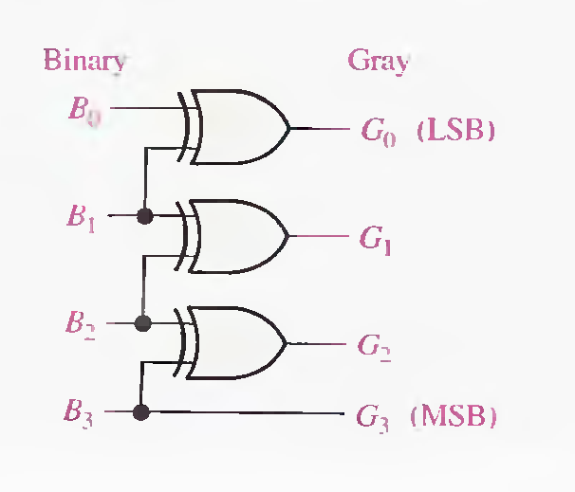
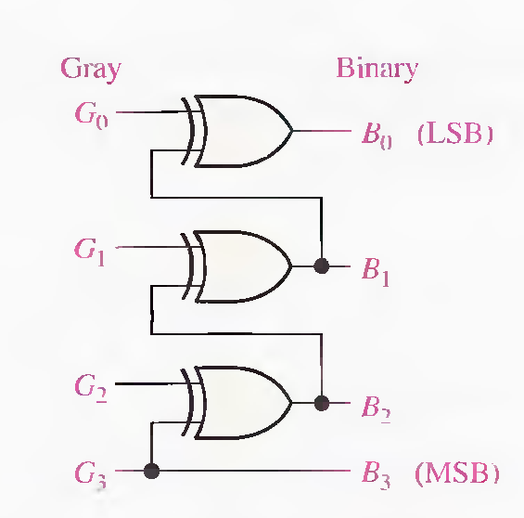

Slide 24
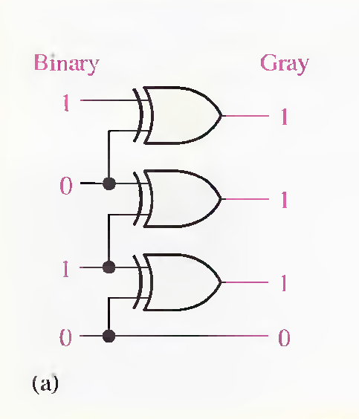
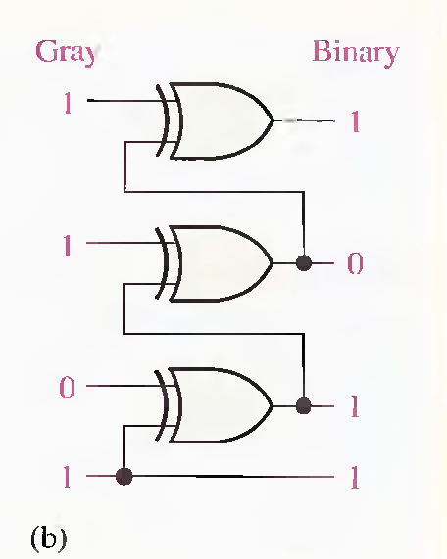

Slide 25

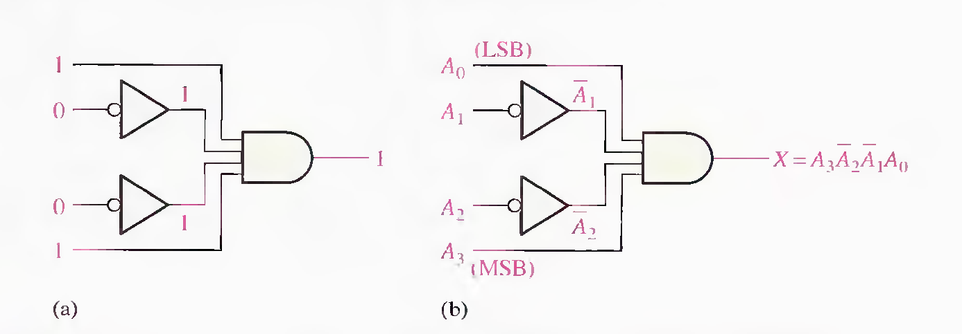
A decoder is a digital circuit that detects the presence of a specified combination of bits (code) on its inputs and indicates the presence of that code by a specified output level.
If a NAND gate is used in place of the AND gate in Figure , a LOW output will indicate the presence of the proper binary code, which is 100 I in this case.

Slide 26
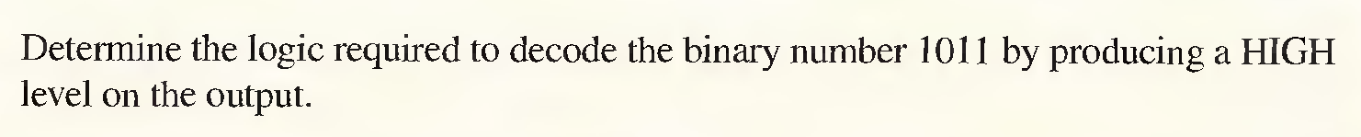
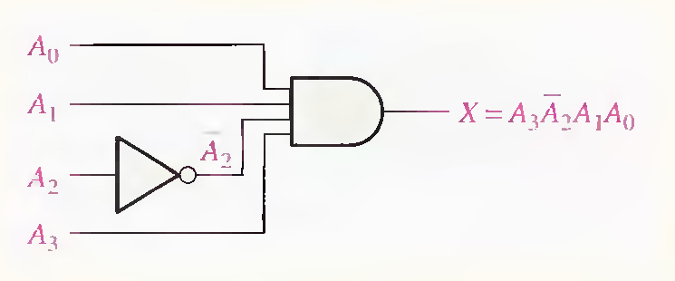
Example

Slide 27

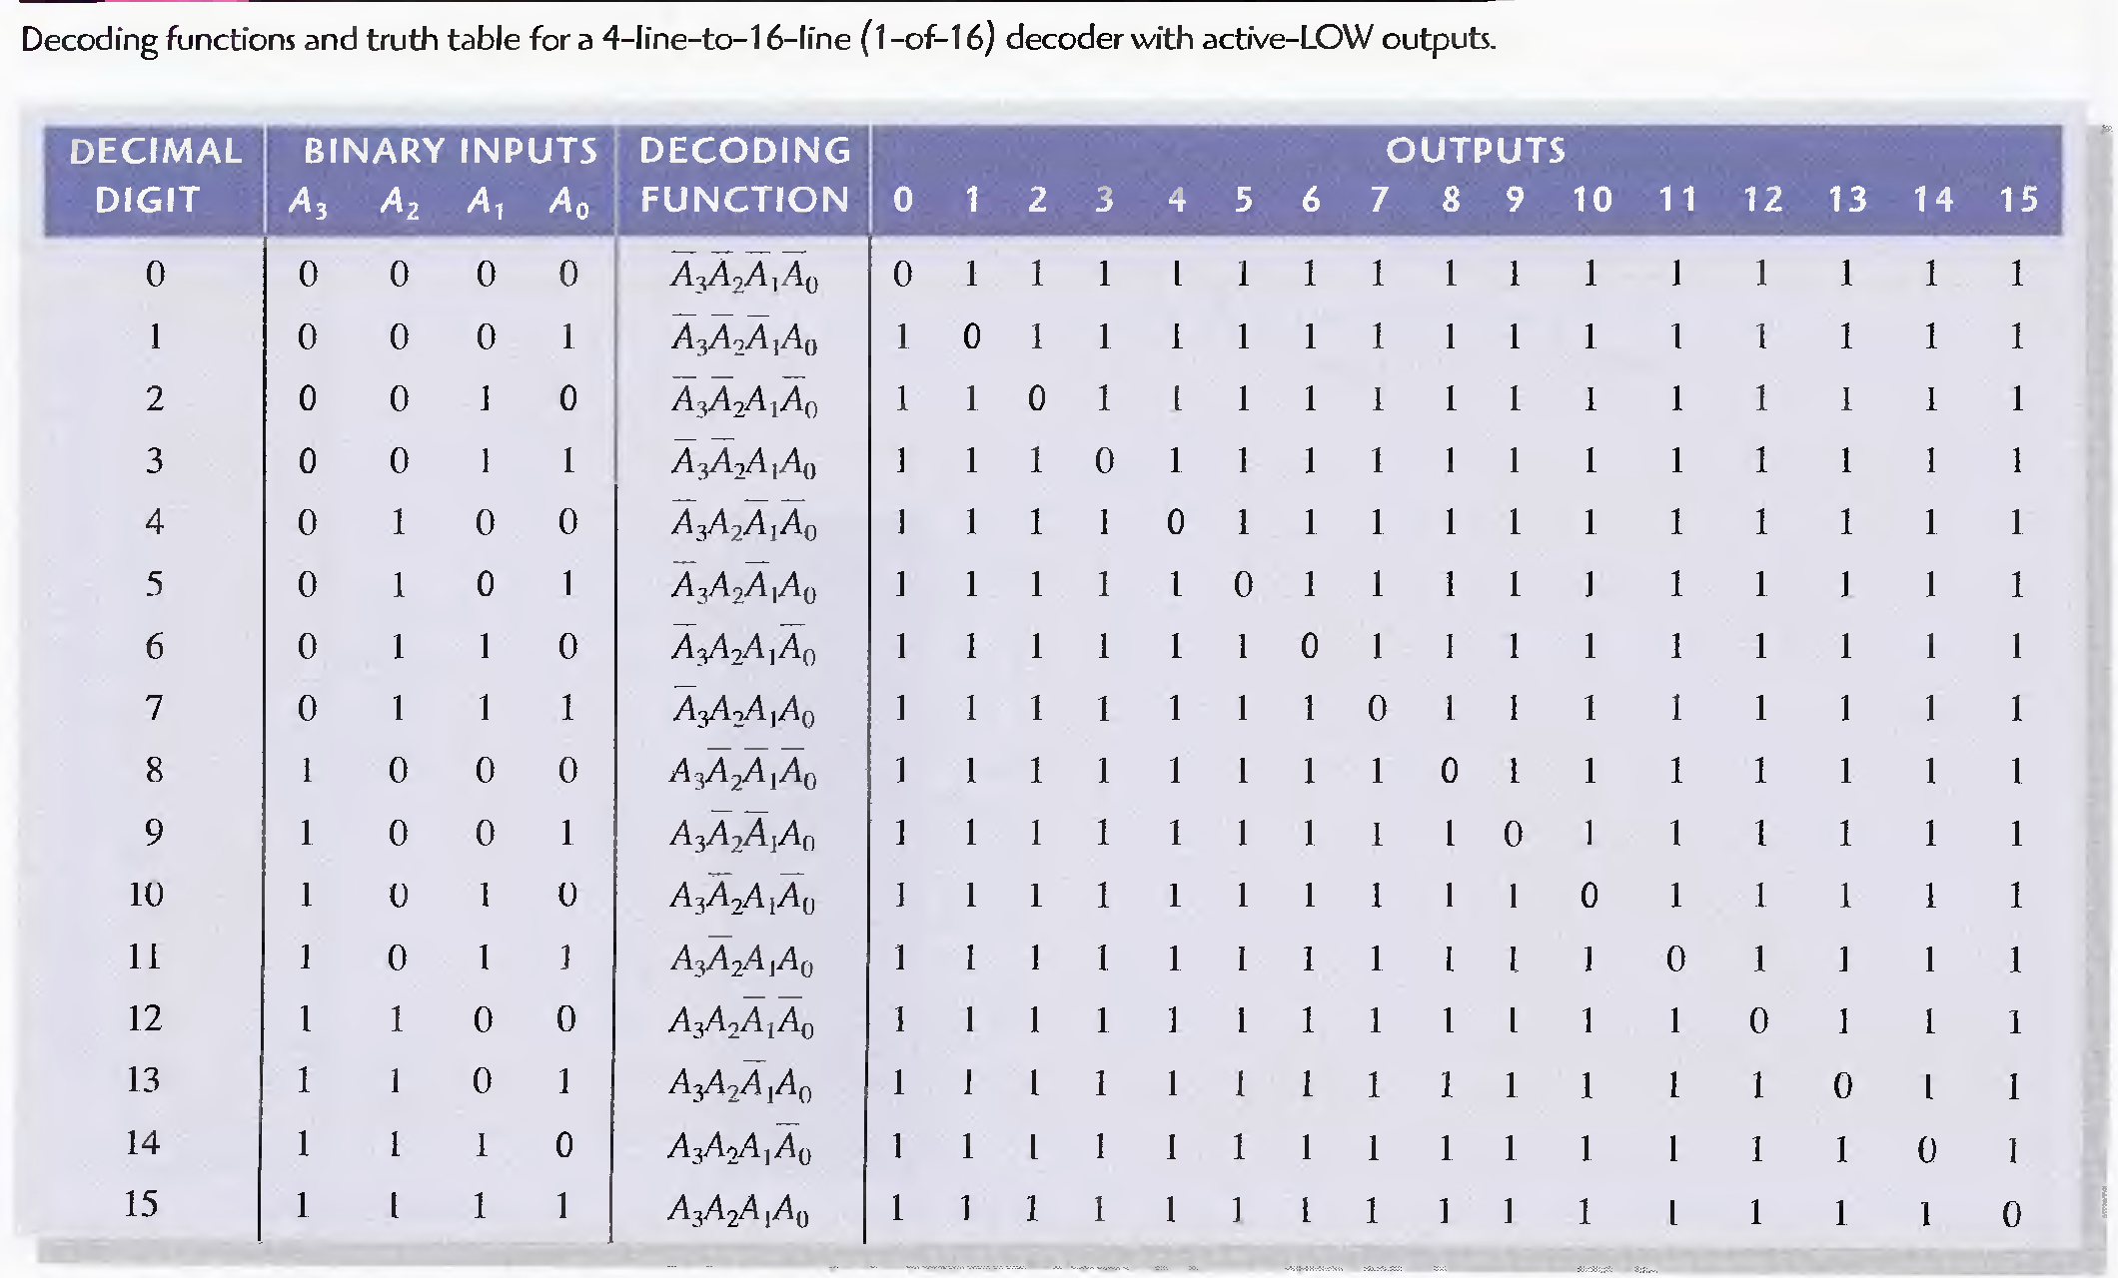
In order to decode all possible combinations of four bits, sixteen decoding gates are required (2^4 = 16). This type of decoder is commonly called either a 4-1ine-to-16-1ine decoder because there are four inputs and sixteen outputs .

Slide 28

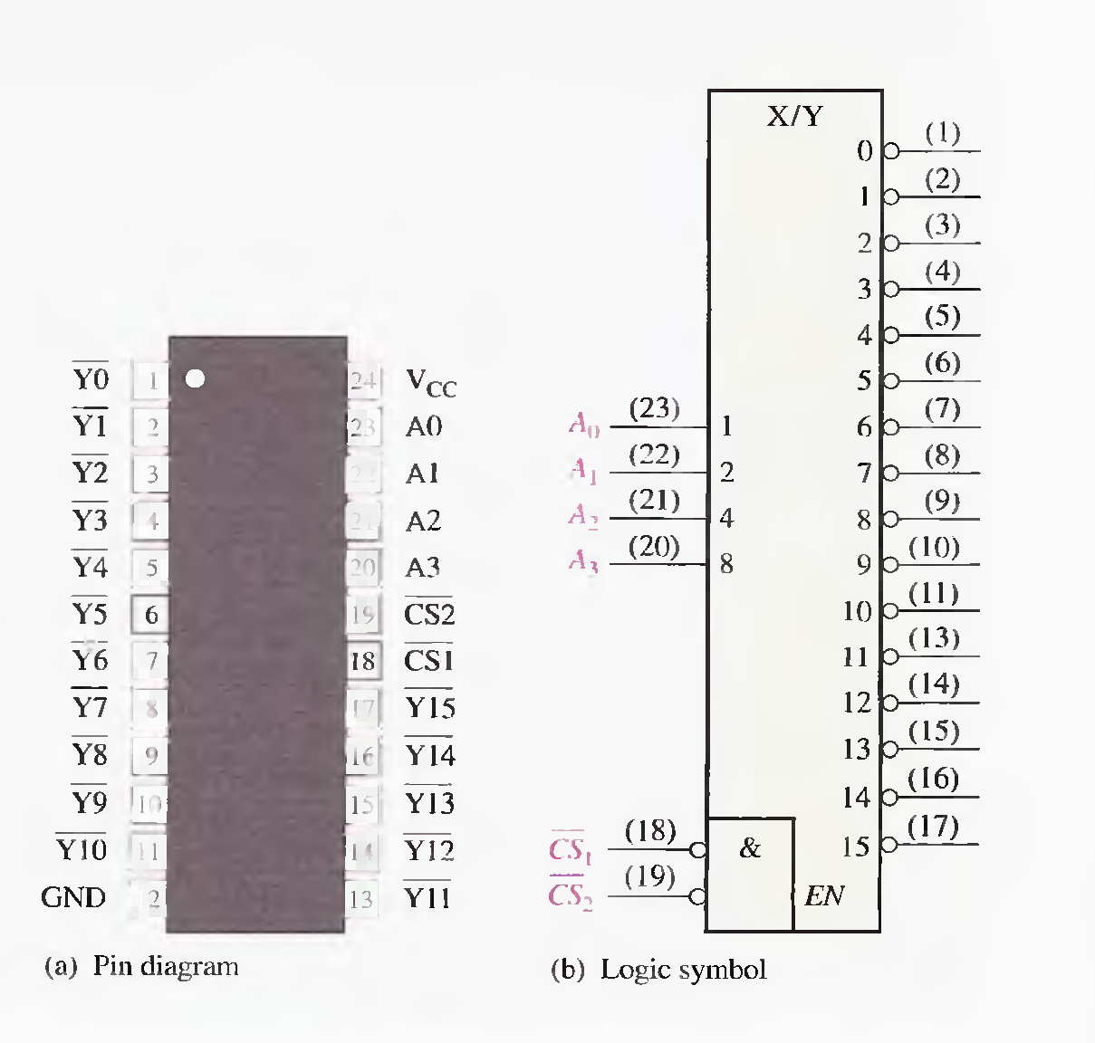
The 74HCl54 is a good example of an IC decoder. There is an enable function (EN) provided on this device, which is implemented with a NOR gate used as a negative-AND. A LOW level on each chip select input, CS1’ and CS 2’ , is required in order to make the enable gate output (EN) HIGH. The enable gate output is connected to an input of each NAND gate in the decoder, so it must be HIGH for the NAND gates to be enabled. If the enable gate is not activated by a LOW on both inputs, then all sixteen decoder outputs (Y) will be HIGH regardless of the states of the four input variables.

Slide 29
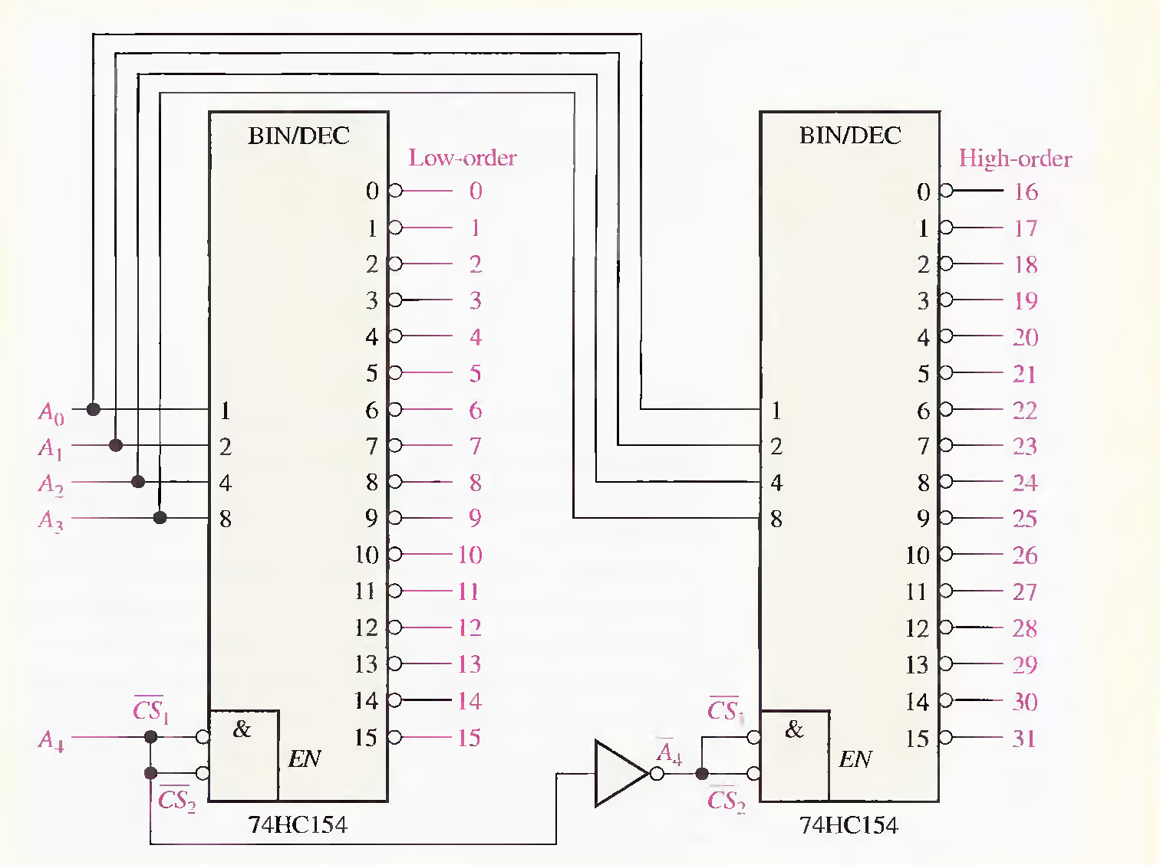
EXAMPLE
Since the 74HC154 can handle only four bits, two decoders must be use d to decode five bits. The fifth bit, A 4 , is connected to the chip select inputs, CSl’ and CS 2’ , of one
decoder, and A4 is connected to the CS l’and CS 2’ inputs of the other decoder, as shown
in Figure . When the decimal number is 15 or less, A4 = 0, the low-order decoder
is enabled, and the high-order decoder is disabled. When the decimal number is greater than 15, A4 = I so A4’ = 0, the high-order decoder is enabled. and the low -order decoder is disabled.

Slide 30

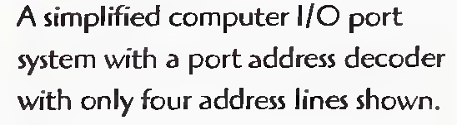
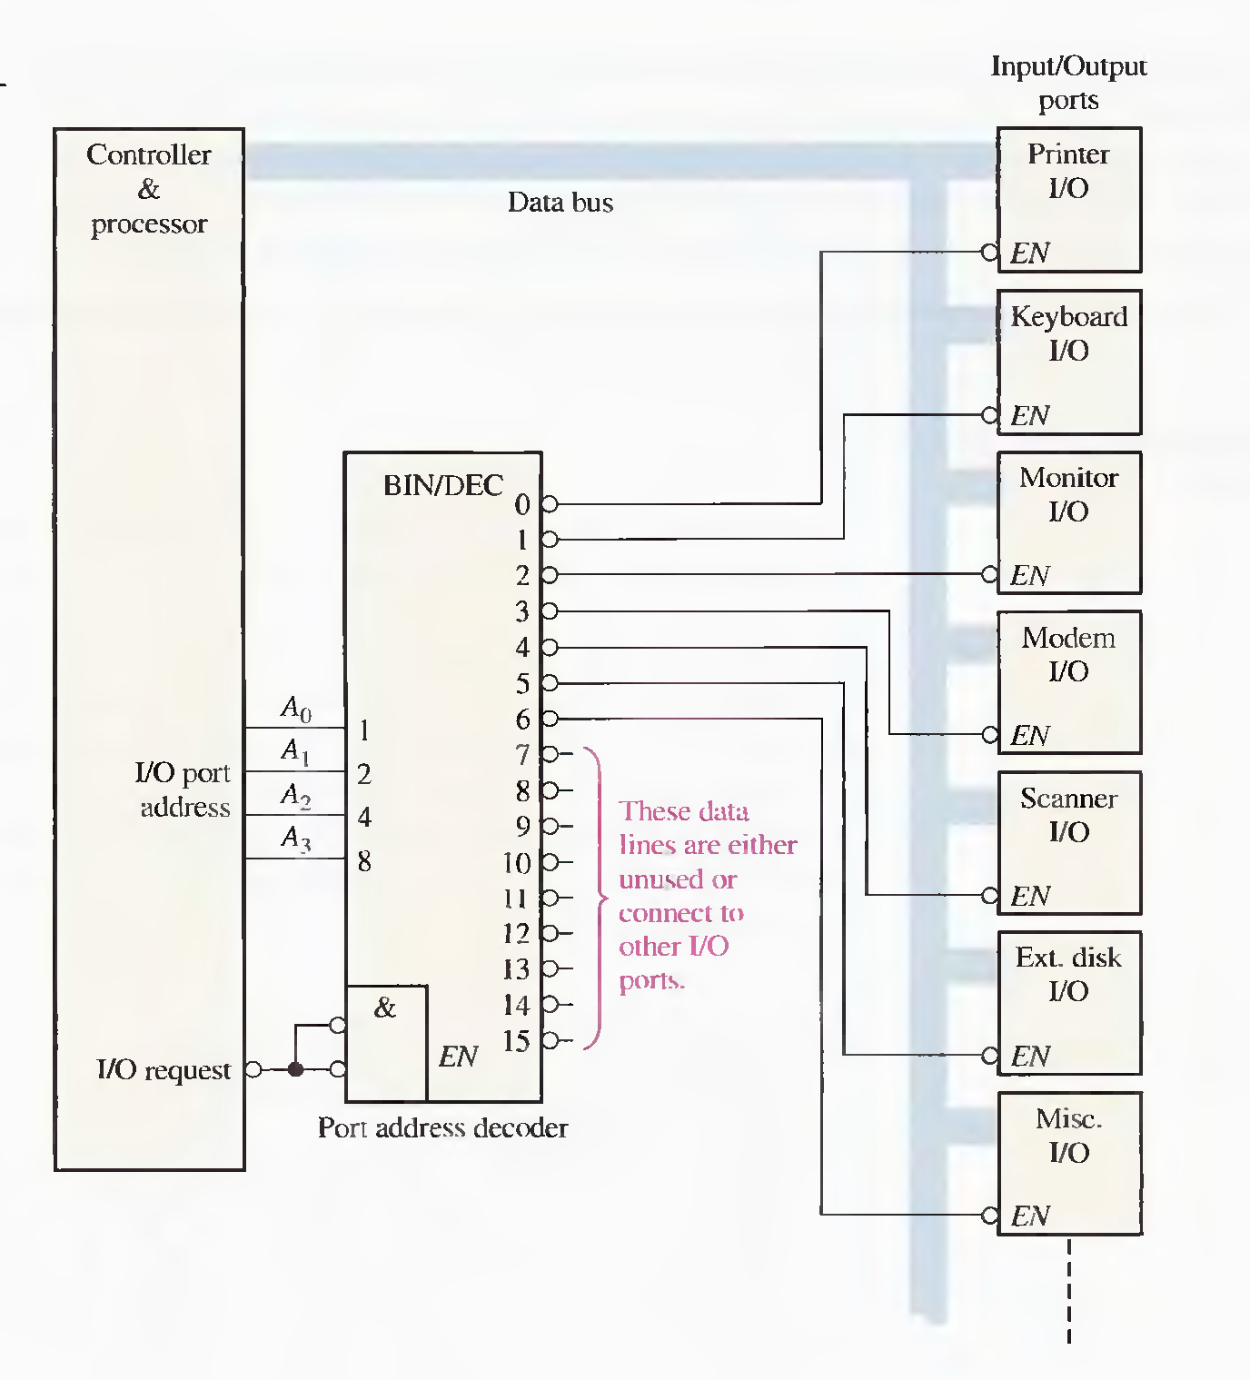

Slide 31

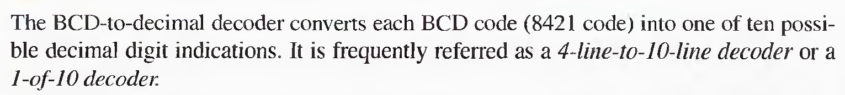

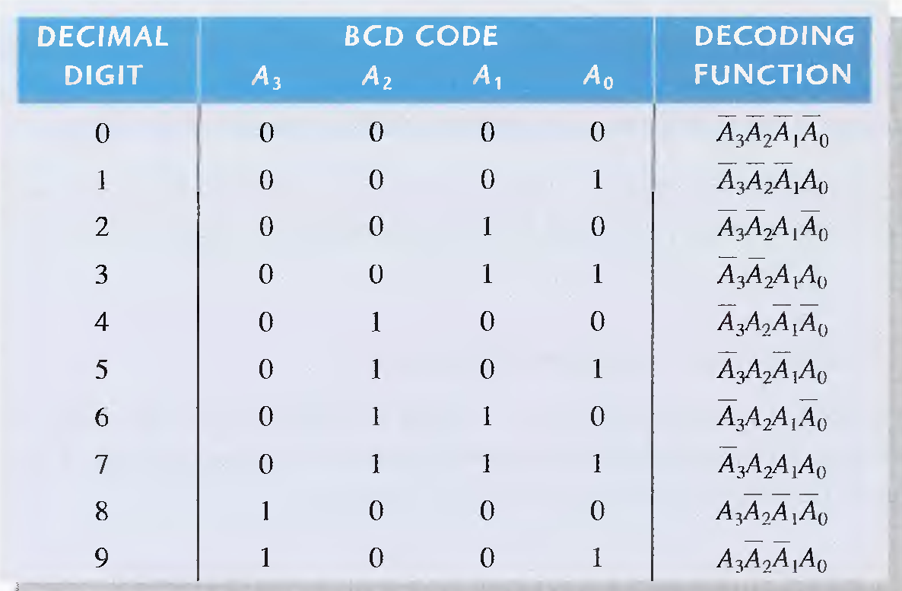

Slide 32



Slide 33





Slide 34


Slide 35





Slide 36




Slide 37


The 74LS148 can be expanded to a 16-1ine-to-4-line encoder by connecting the EO of the higher-order encoder to the EI of the lower-order encoder and negative-ORing the corresponding binary outputs as shown in Figure . The EO is used as the fourth and MSB. This particular configuration produces active-HIGH outputs for the 4-bit binary number.

Slide 38



Slide 39





Slide 40


Slide 41





Slide 42


Figure -2

Slide 43


Example:
The data-input and data-select waveforms in Figure are applied to the multiplexer in Figure -2 . Determine the output waveform in relation to the inputs.

Slide 44

The 74HC157 consists of four separate 2-input multiplexers. Each of the four multiplexers shares a common data-select line and a common Enable. Because there are only two inputs to be selected in each multiplexer, a single data-select input is sufficient. A LOW on the Enable input allows the selected input data to pass through to the output. A HIGH on the Enable input prevents data from going through to the output; that is, it disables the multiplexers. This device may be available in other CMOS or TTL families.

Slide 45



Slide 46



Slide 47




Slide 48


Slide 49





Slide 50


Example

Slide 51




Slide 52

Demultiplexers
A demultiplexer (DEMUX) performs the opposite function from a MUX. It switches data from one input line to two or more data lines depending on the select inputs.
The 74LS138 was introduced previously as a decoder but can also serve as a DEMUX. When connected as a DEMUX, data is applied to one of the enable inputs, and routed to the selected output line depending on the select variables. Note that the outputs are active-LOW as illustrated in the following example…
Data select lines
Data outputs
Enable
inputs
74LS138

Slide 53
Demultiplexers
A
0
A
1
A
Example
Determine the outputs, given the inputs shown.
2
G
1
Solution
G
LOW
2A
The output logic is opposite to the input because of the active-LOW convention. (Red shows the selected line).
G
LOW
2B
Y
0
Y
1
Data select lines
Y
2
Y
Data outputs
3
Y
Enable
inputs
4
Y
5
Y
6
Y
74LS138
7

Slide 54



Slide 55





Slide 56



